Slide 1
Lending Club Case Study SUBMISSION
Name: Prince Adlakha
Pratik Kumar

Slide 2
Background :
Lending Club is the largest online loan marketplace, facilitating personal loans, business loans, and financing of medical procedures. Borrowers can easily access lower interest rate loans through a fast online interface.
Business Objective:
Company wants to understand the driving factors for loan default. Comapny can utilize this analysis for portfolio and risk assessment.

Slide 3
FlowChart :
DATA
SOURCING
DATA
CLEANING
UNIVARIATE
ANALYIS
BIVARIATE
ANALYIS
DERIVED
METRICES

Slide 4
Overall Default Status :
Over-all default loan percentage is 14%.

Slide 5
Funding Analysis :

Slide 6
Country Analysis
Analysing the Top 3 English-Speaking Countries
Sl.No | Questions | Answers
1 | Top English speaking country | USA
2 | Second English speaking country | GBR
3 | Third English speaking country | IND
Top 3 English speaking Countries : USA, GBR and IND.
Assumptions:
Top countries list is generated only for Venture type.
Range of funding amount 5 to 15 million(inclusive).

Slide 7
Sector Analysis:
Sector-wise Investment Analysis
Sl.no | Questions | C1 | C2 | C3
1 | Total number of Investments (count) | 10404 | 542 | 287
2 | Total amount of investment (USD) | 93176222534 | 4728734985 | 2569667552
3 | Top Sector name (no. of investment-wise) | Others | Others | Others
4 | Second Sector name (no. of investment-wise) | Cleantech / Semiconductors | Cleantech / Semiconductors | News, Search and Messaging
5 | Third Sector name (no. of investment-wise) | Social, Finance, Analytics, Advertising | Social, Finance, Analytics, Advertising | Social, Finance, Analytics, Advertising
6 | Number of investments in top sector (3) | 2732 | 137 | 102
7 | Number of investments in second sector (4) | 2145 | 114 | 49
8 | Number of investments in third sector (5) | 1813 | 95 | 32
9 | For point 3 (top sector count-wise), which company received the highest investment? | Kaminario | Notonthehighstreet | ItzCash Card Ltd.
10 | For point 4 (second best sector count-wise), which company received the highest investment? | Sunverge Energy, Inc | Elixent | Mobile2Win India
Top Sectors are : Others, Cleantech / Semiconductors and Social, Finance, Analytics, Advertising
Assumptions:
Top sector list is generated only for Venture fund type.
Range of funding amount 5 to 15 million(inclusive).
Calculated only for top 9 countries.

Slide 8
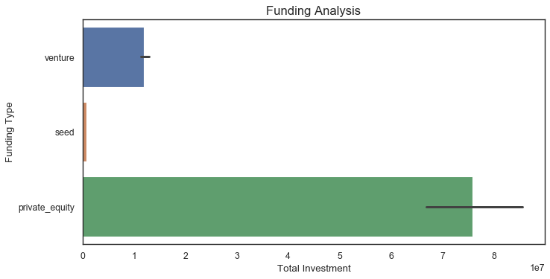
Plot-1 : Funding Analysis

Slide 9
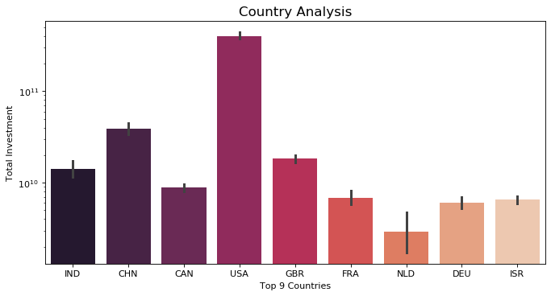
Plot-2 : Country Analysis

Slide 10
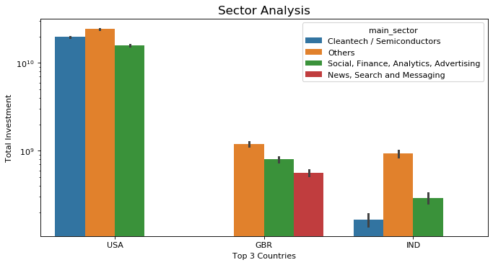
Plot 3 :Sector Analysis:
Assumptions:
This is plotted for top 3 sectors vs top 3 english speaking countries.
Top main_sector is used for plotting this graph.

Slide 11
Conclusions:
On the basis of the analysis,below are conclusions for investments by Sparks Fund:
1.Funding Type to use:
Venture is the most suited funding type with investment of~ 11.9 Million USD
2.Top three countries to invest in:
USA
GBR
IND
3.Top three sectors to invest are:
Others
Cleantech and Semiconductors
Social, Finance, Analytics and Advertising

